Slide 1
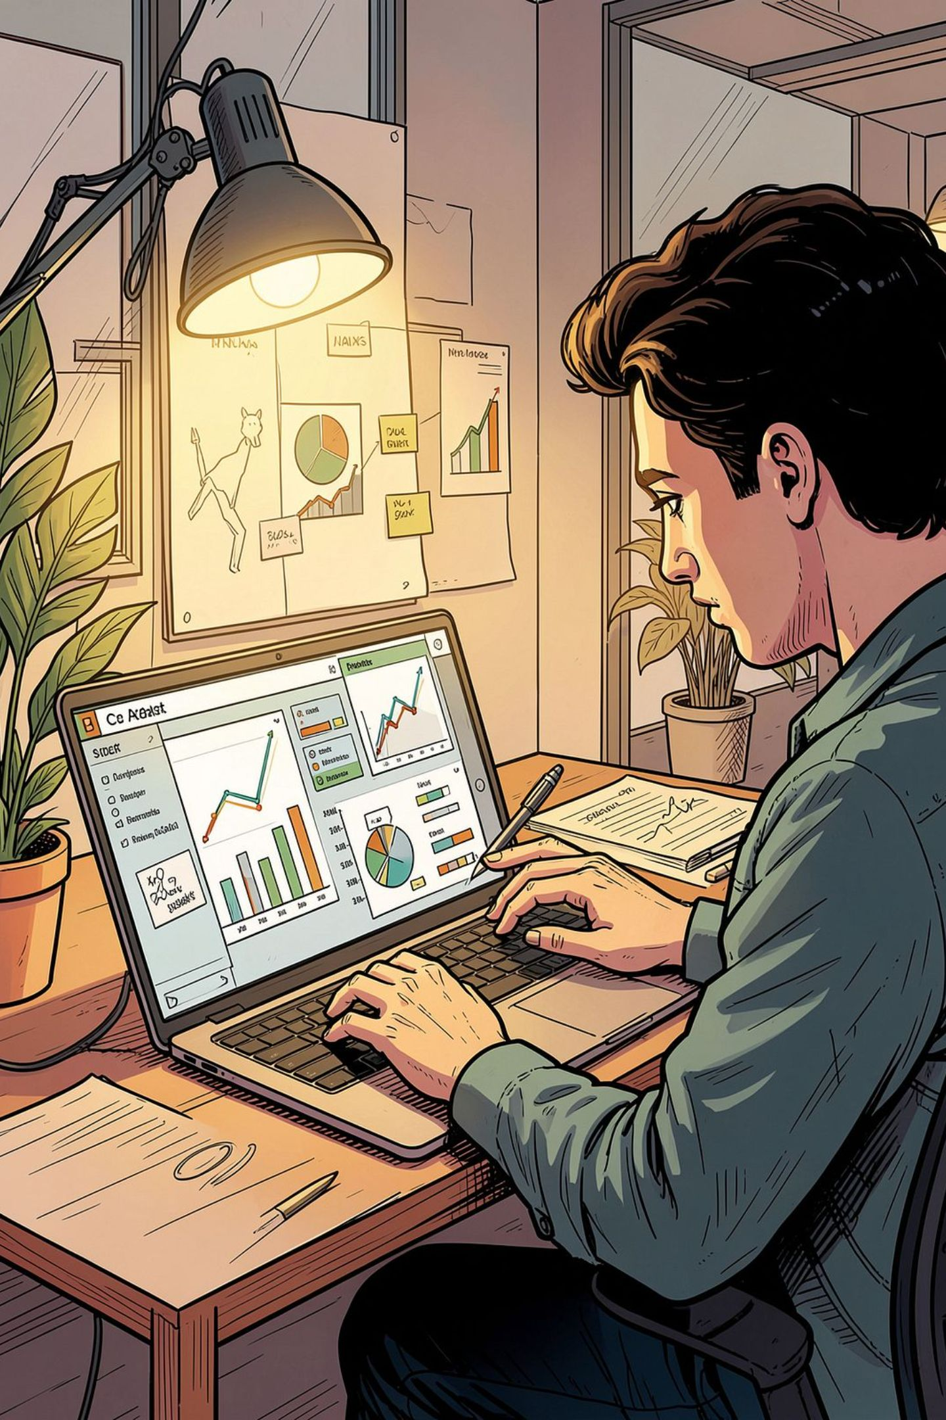
Customer Shopping Behavior Analysis
Analysis of 3,900 purchases to surface spending patterns, customer segments, product preferences, and subscription behavior for strategic decisions.

Slide 2
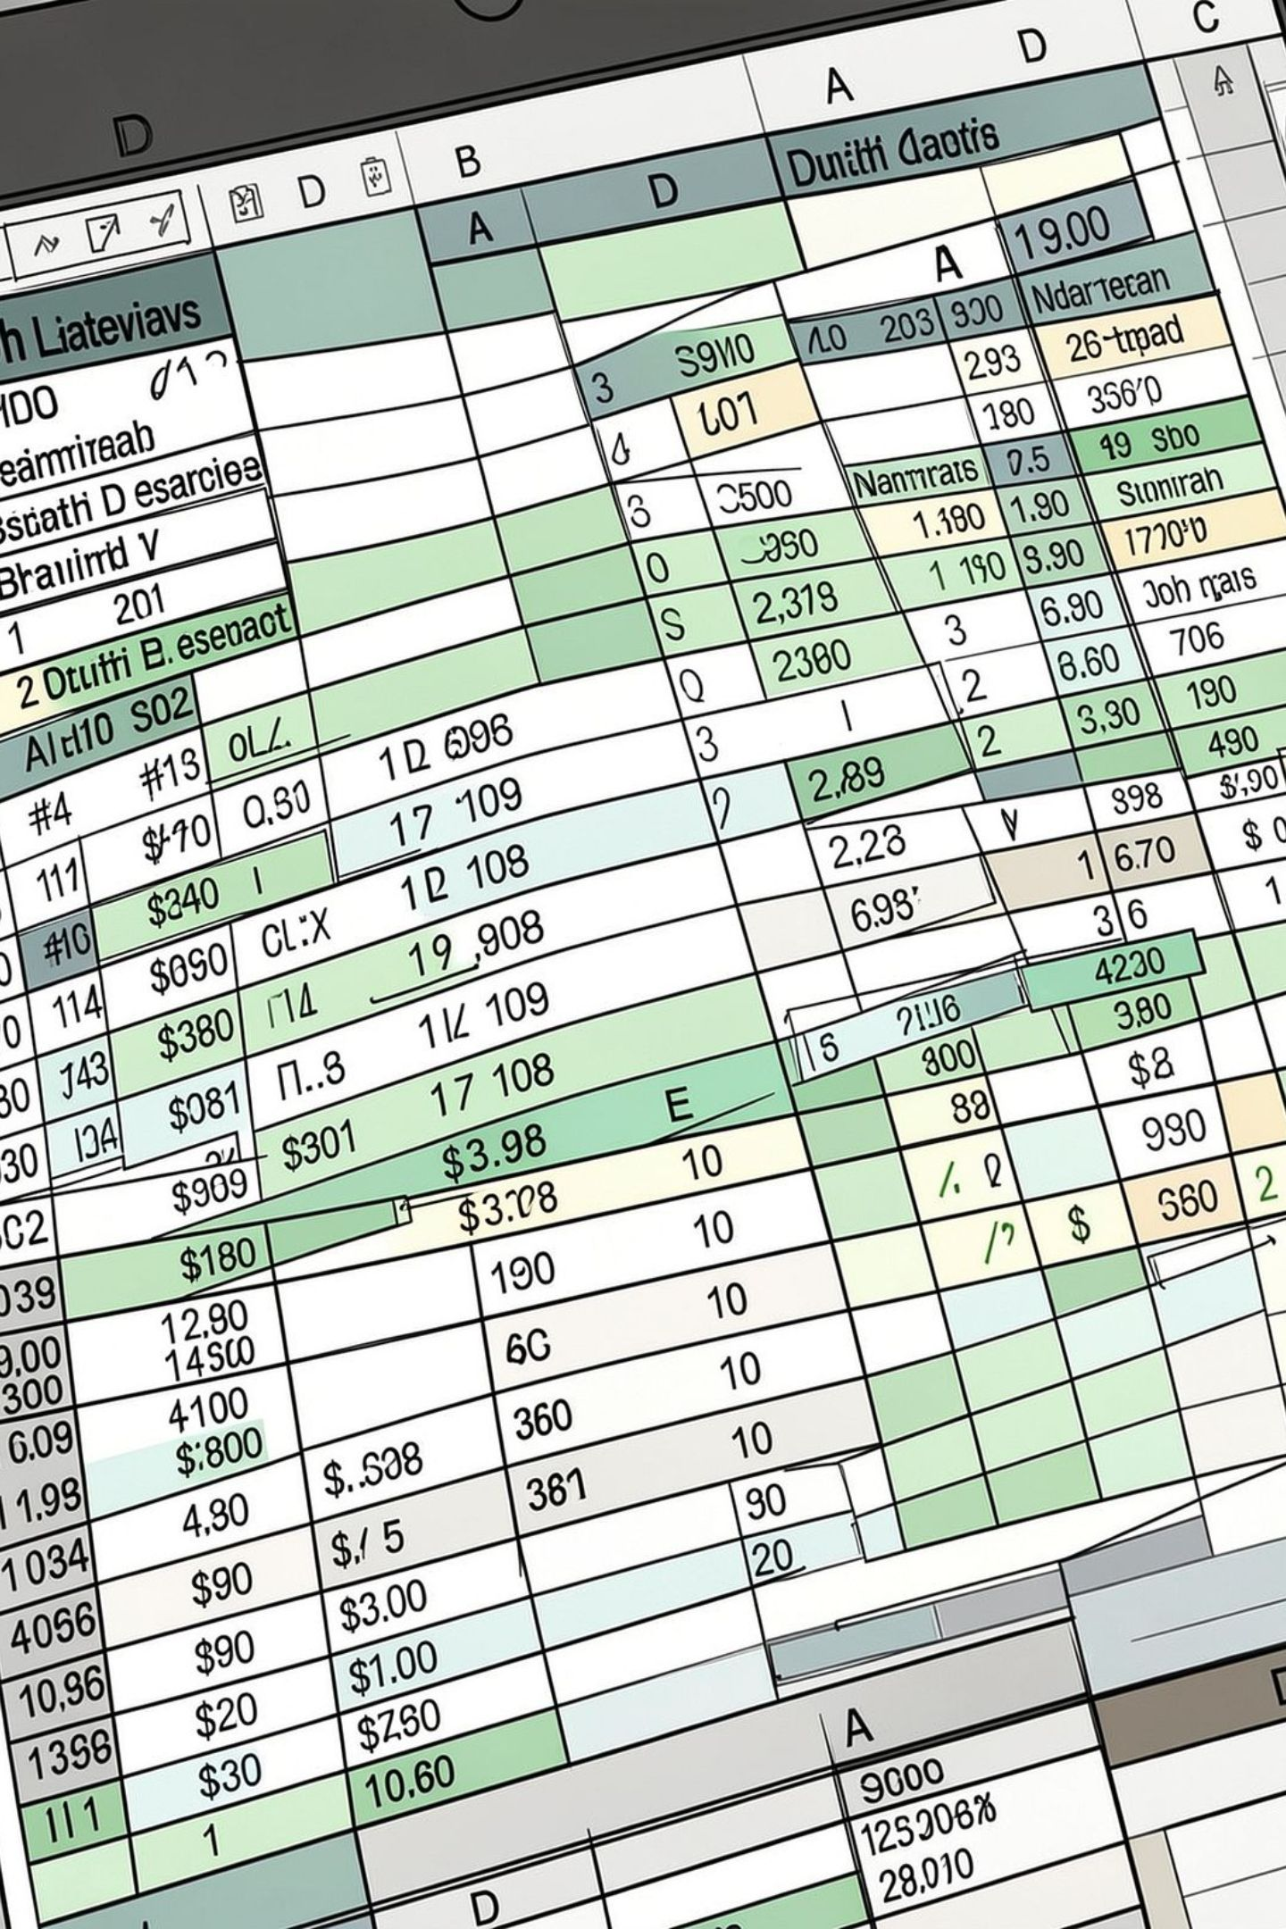
Dataset Snapshot
Rows & Columns
Key Features
Missing Data
Demographics, purchase details, behavior signals (discounts, frequency, ratings)
37 missing values in Review Rating
3,900 rows · 18 columns

Slide 3

Data Preparation (Python)
Loaded with pandas, inspected via df.info() and .describe(). Handled nulls and standardized column names to snake_case.
Feature Engineering
Added age_group bins and purchase_frequency_days. Connected cleaned DataFrame to PostgreSQL for SQL analysis.
Imputed Review Rating by category median
Dropped redundant promo_code_used (kept discount_applied)

Slide 4
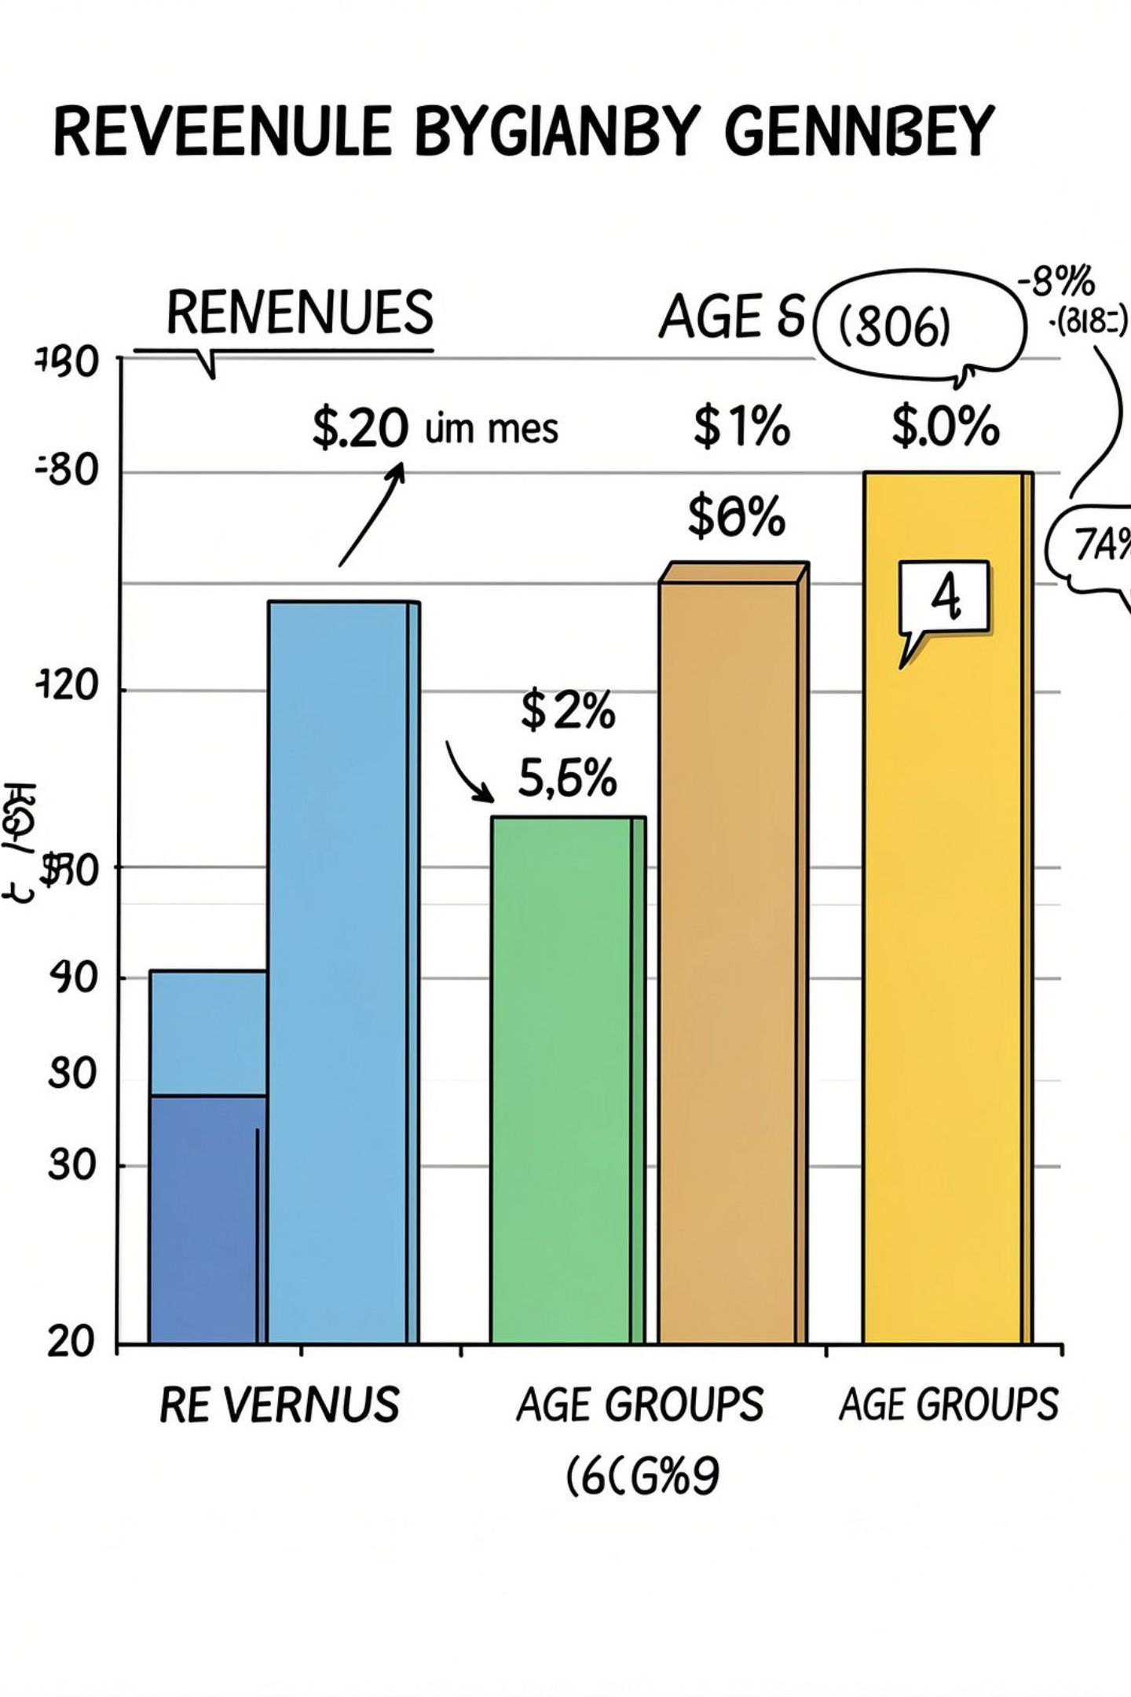
Revenue & Demographics (SQL)
Revenue by Gender
Male: 157,890 · Female: 75,191
Subscribers vs Non-Subscribers
Subscribers (1,053) avg spend $59.49 · Non-subscribers (2,847) avg $59.87
Revenue by Age Group
Young Adult: 62,143 · Middle-aged: 59,197 · Adult: 55,978 · Senior: 55,763

Slide 5
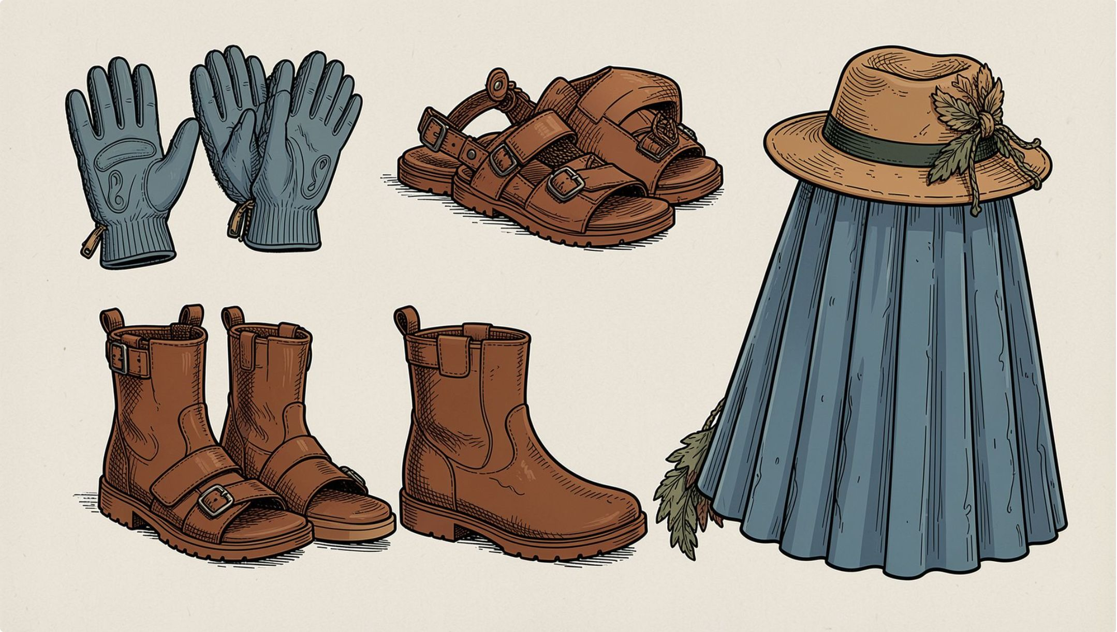
Top Products & Ratings
Top Rated Items
Gloves — 3.86
Sandals — 3.84
Boots — 3.82
Hat — 3.80
Skirt — 3.78
37 missing ratings were imputed by category median before computing averages.

Slide 6
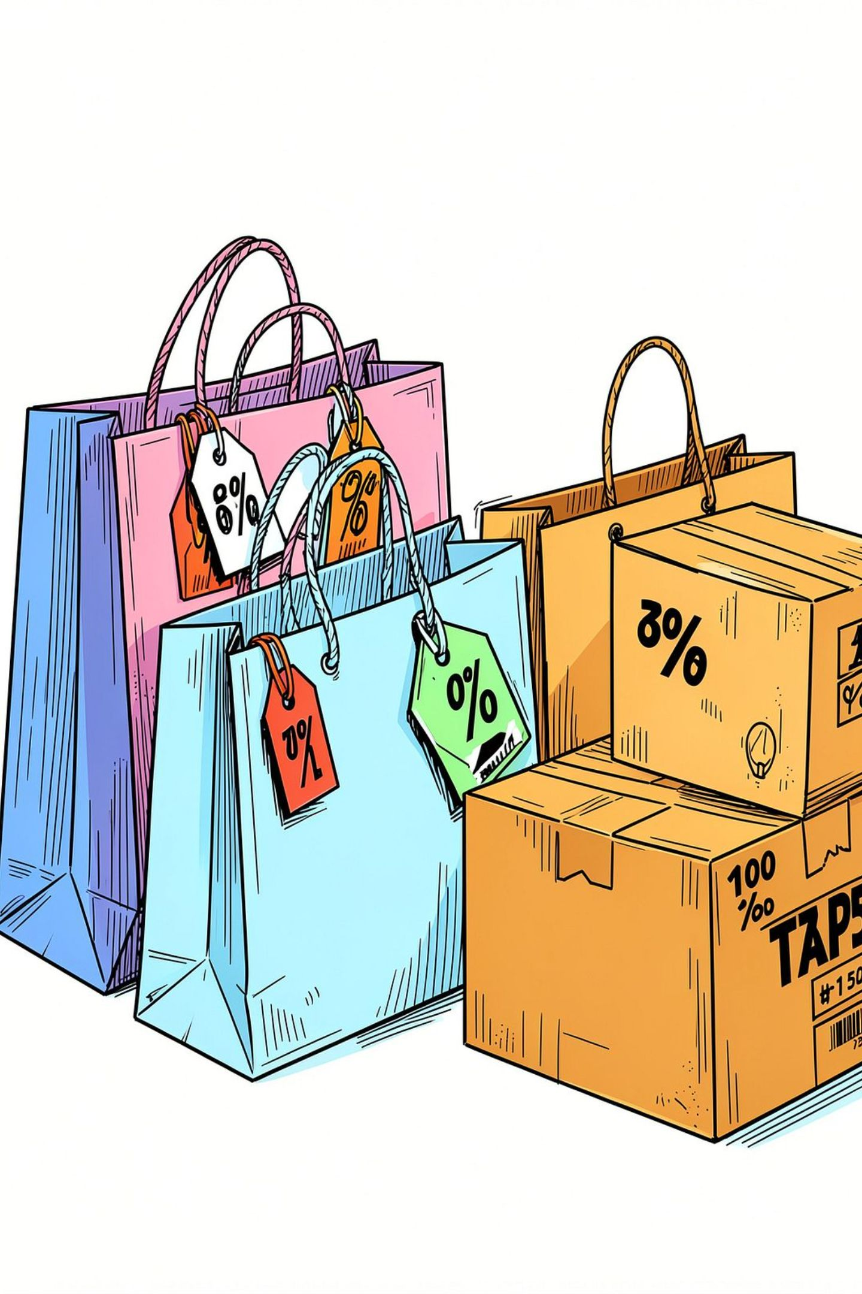
Sales, Discounts & Shipping Insights
Discount-Dependent Products
High-Spending Discount Users
Shipping Comparison
839 rows identified where discounts were used but purchase > average amount
Avg purchase: Standard $58.46 · Express $60.48
Hat 50.00% · Sneakers 49.66% · Coat 49.07% · Sweater 48.17% · Pants 47.37%

Slide 7
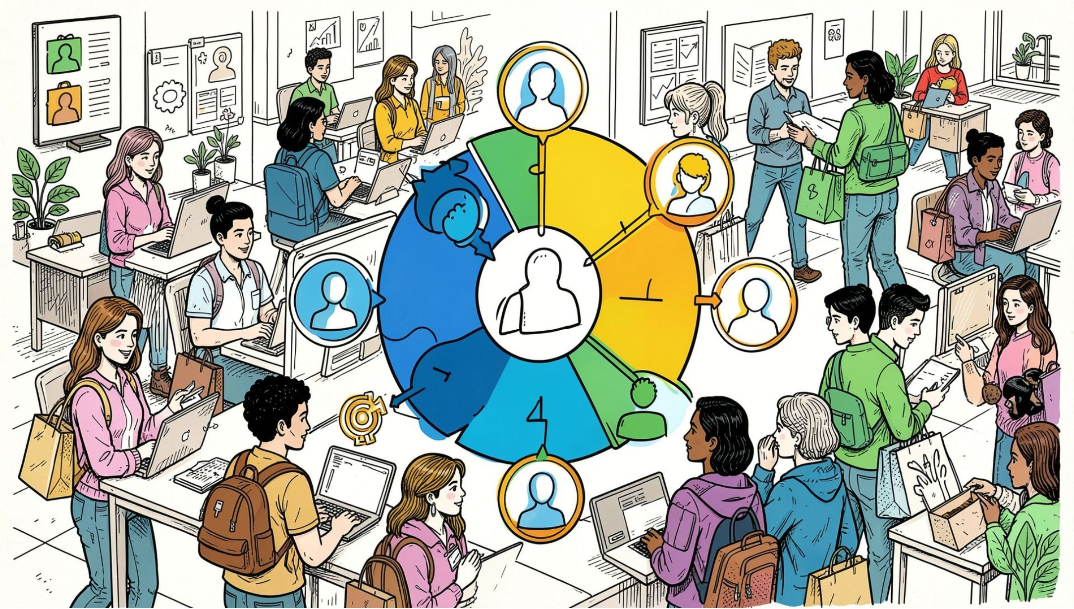
Customer Segments
Segments derived from purchase history:
1
Loyal
3,116 customers
2
Returning
701 customers
3
New
83 customers

Slide 8
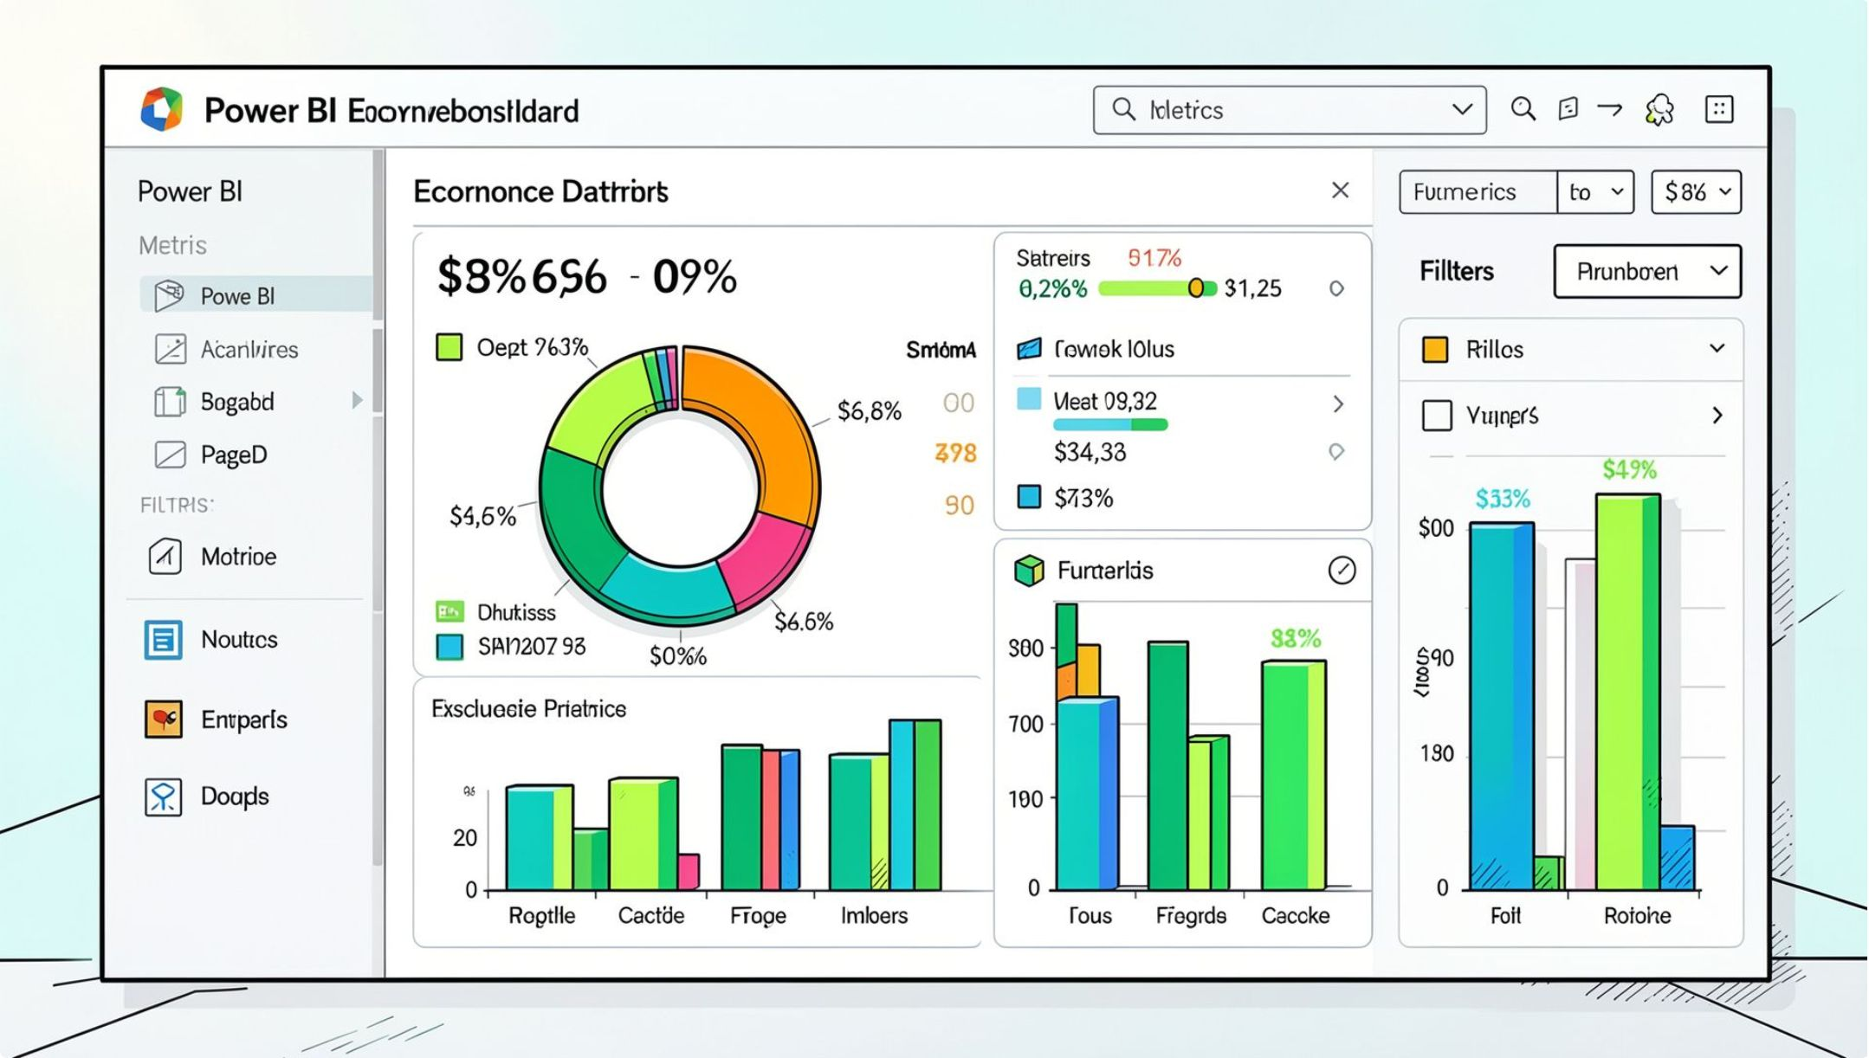
Power BI Dashboard Highlights
Interactive dashboard built in Power BI to visualize key metrics and support exploration.
Number of Customers: 3.9K
Average Purchase Amount: $59.76
Average Review Rating: 3.75
Subscription: 27% Yes · 73% No

Slide 9
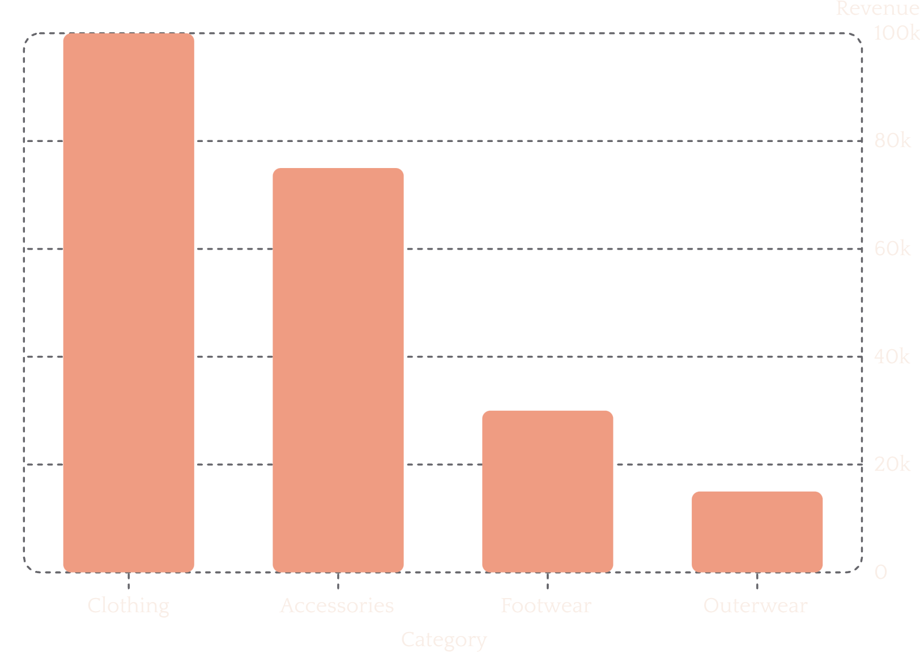
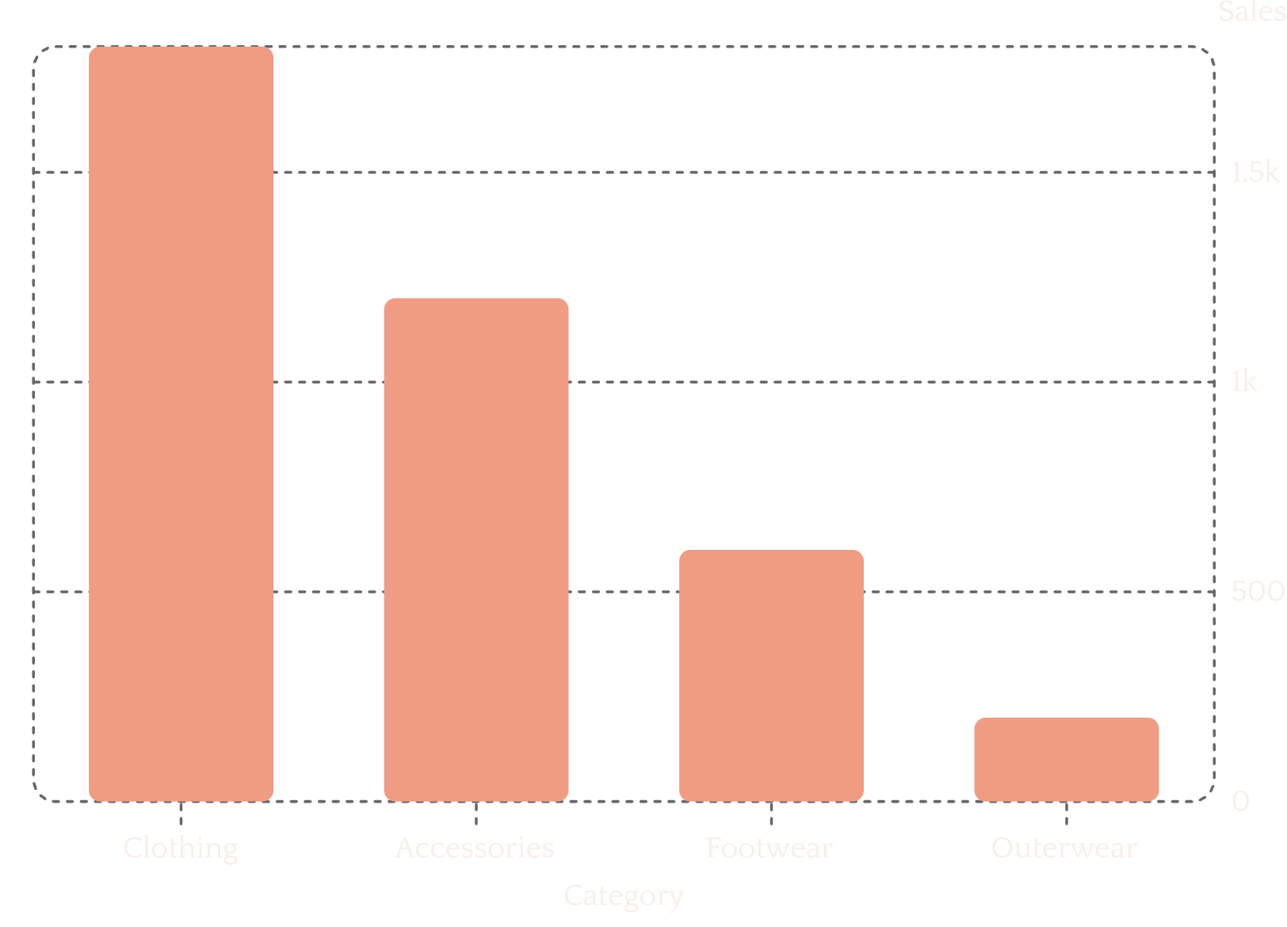
Sales & Revenue Visuals
Revenue and sales by category — use these visuals to prioritize assortment and promotions.

Slide 10

Business Recommendations
Boost Subscriptions
Promote exclusive benefits to increase subscriber base and recurring revenue.
Loyalty Programs
Reward repeat buyers to move them into the Loyal segment.
Review Discount Policy
Balance short-term sales lifts with margin protection for discount-dependent products.
Targeted Marketing
Focus campaigns on high-revenue age groups and express-shipping users.
Product Positioning
Feature top-rated and best-selling products in promotions and homepage merchandising.
Next steps: A/B test subscription offers and loyalty incentives; monitor impact on CLV and margin.

